Slide 1
Object Oriented Programming with Java
Day 13

Slide 2
Understanding the Content Pane
Top-level container
JFrame
Contains a content pane, menu bar, and glass pane
Containment hierarchy
A tree of components that has a top-level container as its root
Content pane
Contains all the visible components in the container’s user interface

Slide 3
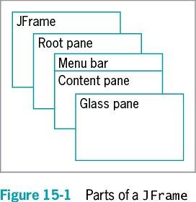
Understanding the Content Pane

Slide 4
Understanding the Content Pane
getContentPane() method
You can add components directly to JFrames without explicitly calling getContentPane() using the add() method
You can use the remove() and setLayout() methods also
Other methods must use getContentPane()
setBackground()

Slide 5
Using Color
Color class
Defines colors for you to use in your applications
Use with setBackground() and setForeground()
Defines named constants that represent 13 colors
Create your own Color object
Color someColor = new Color(r, g, b);
Discover the red, green, or blue components of any existing color with getRed(), getGreen(), and getBlue()

Slide 6
Learning More About Layout Managers
Layout manager
Controls the size and position of components inside a Container object
Determines how the components are sized and positioned within it
Is an interface class that is part of Java SDK
Aligns components so that they do not:
Crowd each other
Overlap

Slide 7
Learning More About Layout Managers
Layout manager (cont’d.)
Arranges components within a Container
Each component you place within a Container can also be a Container itself
You can assign layout managers within layout managers
Java platform–supplied layout managers
FlowLayout
GridLayout
BorderLayout
CardLayout
GridBagLayout
BoxLayout

Slide 8
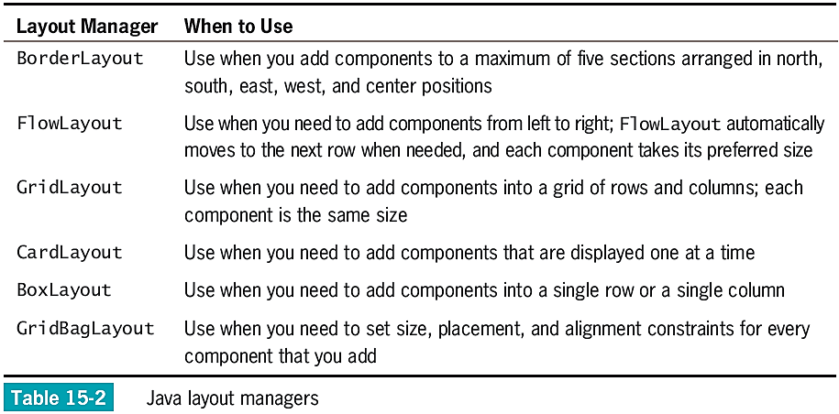
Learning More About Layout Managers

Slide 9
Using BorderLayout
BorderLayout manager
The default for all content panes
Use with any container that has five or fewer components
Component containers can hold more components
Components fill the screen in five regions:
North
South
East
West
Center

Slide 10
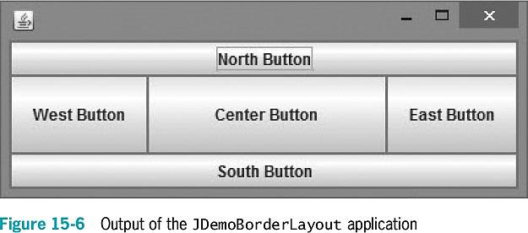
Using BorderLayout

Slide 11
Using FlowLayout
FlowLayout manager
Arranges components in rows across the width of a Container
When you add a Component:
It is placed to the right of previously added components in a row
If the current row is filled, the Component is placed to start a new row
Each Component retains its preferred size
You can use three constants to align Components with a Container:
FlowLayout.LEFT
FlowLayout.CENTER
FlowLayout.RIGHT
If the alignment is not specified, Components are center-aligned

Slide 12
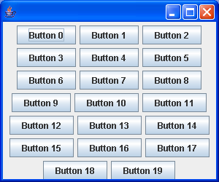
Using FlowLayout
invalidate()
Marks the container as needing to be laid out
validate()
Causes components to be rearranged based on the newly assigned layout
http://www.java2s.com/Code/Java/Swing-JFC/DemonstratesFlowLayout.htm

Slide 13
Using GridLayout
GridLayout manager class
Arranges components into equal rows and columns
When you create a GridLayout object:
Indicate the numbers of rows and columns
Specify rows first and then columns
The container surface is divided into a grid
The following statement establishes a GridLayout:
con.setLayout(new GridLayout(4, 5));

Slide 14
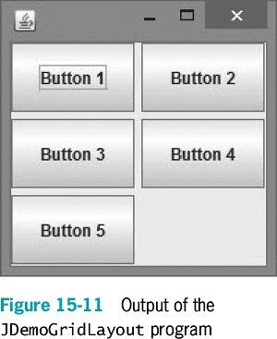
Using GridLayout
The following statement establishes a GridLayout with three horizontal rows, two vertical columns, and vertical gaps of five pixels each:
private GridLayout layout = new GridLayout(3, 2, 5, 5);
You can use 0 for the number of columns or rows

Slide 15
Using CardLayout
CardLayout manager
Generates a stack of containers or components one on top of another
Each component in the group is referred to as a card
Multiple components share the same display space
To create a card layout, use one of two constructors:
CardLayout()
Creates a card layout without a horizontal or vertical gap
CardLayout(int hgap, int vgap)
Creates a card layout with the specified horizontal and vertical gaps
To add a component to a content pane, use:
add(aString, aContainer);

Slide 16
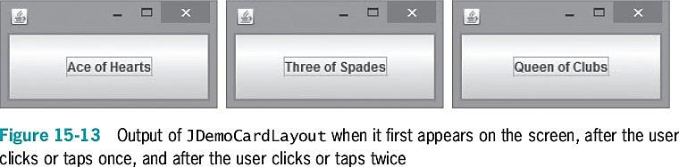
Using CardLayout

Slide 17
Using Advanced Layout Managers
GridBagLayout manager
Adds Components to precise locations within the grid
Indicates that specific Components should span multiple rows or columns within the grid
You must set the position and size for each component
You must customize one or more GridBagConstraints objects
BoxLayout manager
Allows multiple components to be laid out either vertically or horizontally

Slide 18
Using the JPanel Class
JPanel
A plain, borderless surface
Can hold lightweight UI components
Double buffering
Additional memory space will be used to draw the JPanel offscreen when it is updated

Slide 19
Using the JPanel Class
Constructors
JPanel()
JPanel(LayoutManager layout)
JPanel(Boolean isDoubleBuffered)
JPanel(LayoutManager layout, Boolean isDoubleBuffered)
To add a component to JPanel:
Call the container’s add() method
Use the component as an argument

Slide 20
Creating JScrollPanes
JScrollPane
Provides scroll bars along the side or bottom of a pane
Enables the user to scroll initially invisible parts of the pane into view
Constructors
JScrollPane()
JScrollPane(Component)
JScrollPane(Component, int, int)
JScrollPane(int, int)

Slide 21
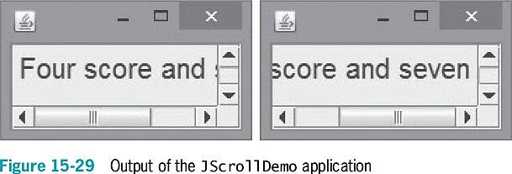
Creating JScrollPanes
To force the display of the scroll bar, use the following ScrollPaneConstants class variables:
ScrollPaneConstants.HORIZONTAL_SCROLLBAR_AS_NEEDED
ScrollPaneConstants.HORIZONTAL_SCROLLBAR_ALWAYS
ScrollPaneConstants.HORIZONTAL_SCROLLBAR_NEVER
ScrollPaneConstants.VERTICAL_SCROLLBAR_AS_NEEDED
ScrollPaneConstants.VERTICAL_SCROLLBAR_ALWAYS
ScrollPaneConstants.VERTICAL_SCROLLBAR_NEVER

Slide 22
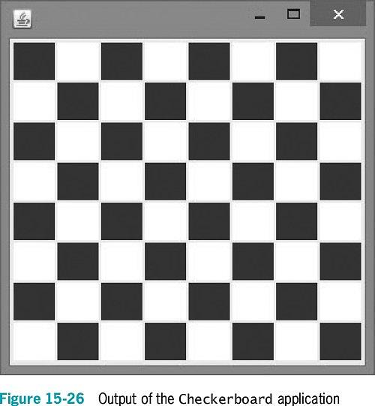
Using the JPanel Class
Write an application that displays a checkerboard.
Which layout class best fits this task?
Notes:
Advise students not to copy the solution from the book.

Slide 23
A Closer Look at Events and Event Handling
Events
Objects that the user initiates
EventObject
The parent class for all event objects
Descends from the Object class
The parent of the AWTEvent class
AWTEvent is the parent of ActionEvent and ComponentEvent

Slide 24
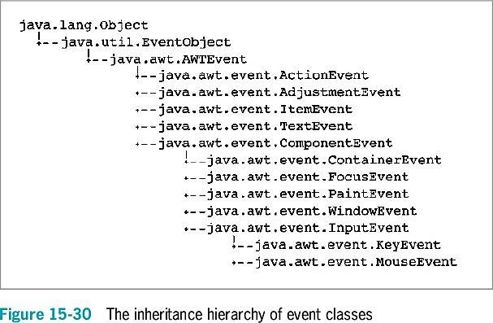
A Closer Look at Events and Event Handling

Slide 25
A Closer Look at Events and Event Handling
ActionEvents
Focus on changes in a component
MouseEvents
Focus on what the user does manually with the mouse
The computer’s operating system notifies the user when an AWTEvent occurs
You can ignore AWTEvents
You must implement an appropriate interface for your class to receive events

Slide 26
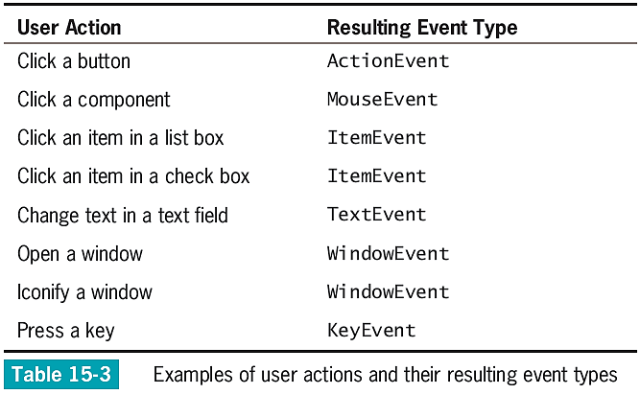
A Closer Look at Events and Event Handling

Slide 27
A Closer Look at Events and Event Handling
Event handler
An interface method such as actionPerformed()
Called automatically when an appropriate event occurs
Adapter class
Implements all methods in an interface
Provides an empty body for each method
When you extend the adapter class, you need to write only the methods you want to use
Do not bother creating empty methods for the others

Slide 28
A Closer Look at Events and Event Handling
You create an event handler when you write code for the listener methods
Tell the class how to handle events
You must register an instance of the class with the component that the event affects
For any <name>Listener, use:
object.add<name>Listener(Component)

Slide 29
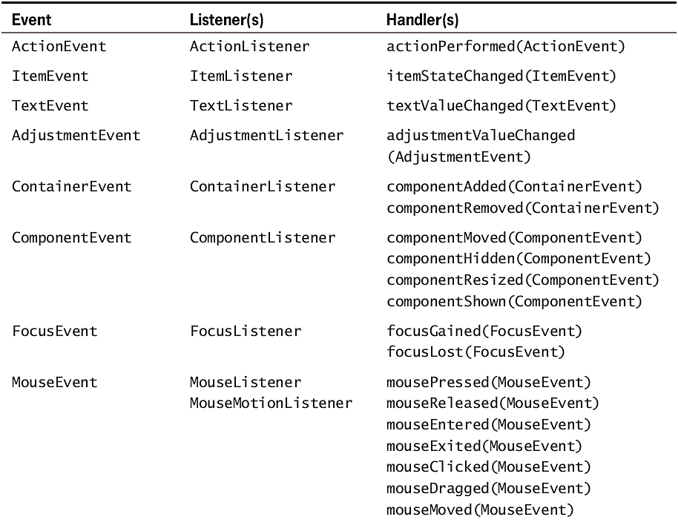
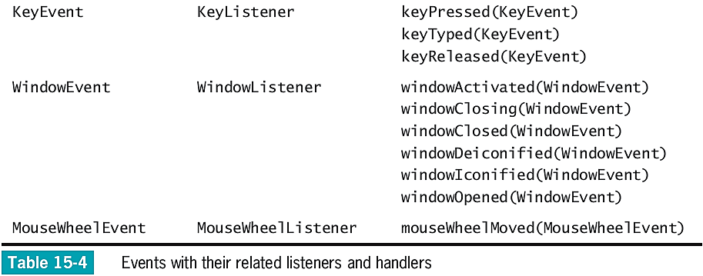

Slide 30
An Event-Handling Example: KeyListener
KeyListener interface
Use to receive actions that the user initiates from the keyboard
KeyListener contains three methods:
keyPressed()
keyTyped()
Use to discover which character was typed
Does not execute calls from action keys
keyReleased()
Does not take action while the user holds down the key

Slide 31
An Event-Handling Example: KeyListener
KeyEvent class
Contains virtual key codes
Represent keyboard keys that have been pressed
Virtual key code constants have names such as VK_SHIFT and VK_ALT

Slide 32
Using AWTEvent Class Methods
AWTEvent classes
Contain methods that return information about an event
All Components have these methods:
addComponentListener()
addFocusListener()
addMouseListener()
addMouseMotionListener()

Slide 33
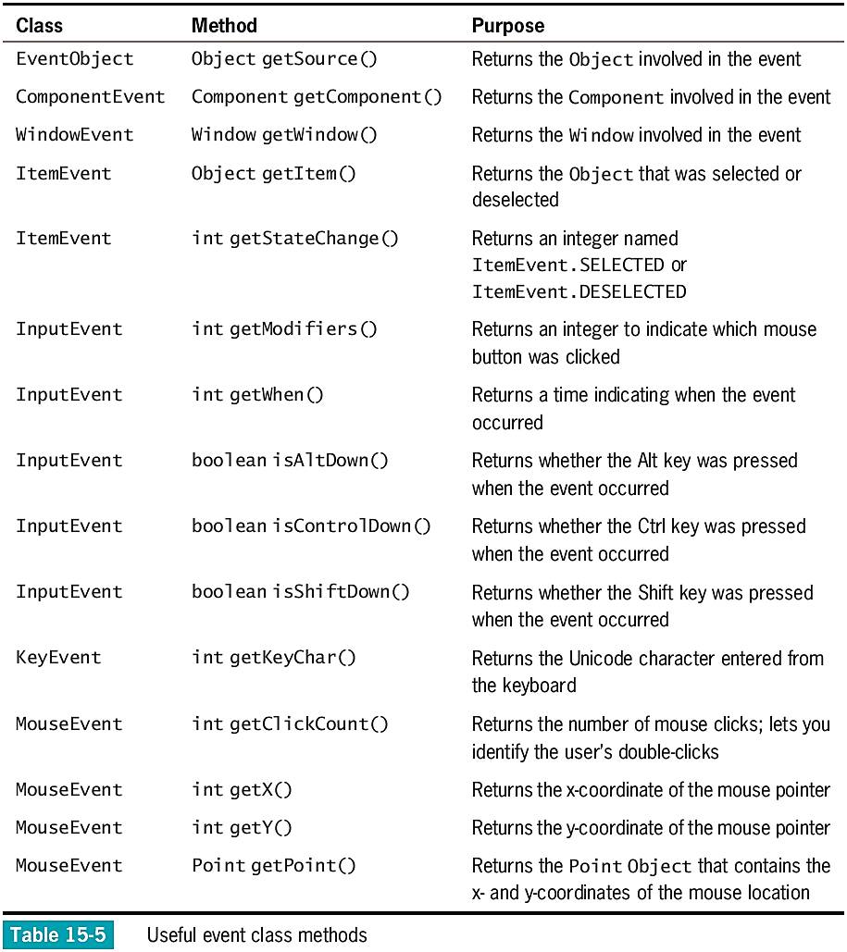

Slide 34
Using AWTEvent Class Methods
To call Event class methods, use the object-dot-method format
For example, if you have a KeyEvent named inputEvent and an integer named unicodeVal, the following statement is valid:
unicodeVal = inputEvent.getKeyChar();
When you use an event object within a handler method to obtain information, add a dot and the appropriate method name
When you use an event, you can use any methods that belong to any superclass of the event

Slide 35
Understanding x- and y-Coordinates
x-axis
Horizontal position
y-axis
Vertical position
0, 0
Upper-left corner of any display
x-coordinate
y-coordinate

Slide 36
Handling Mouse Events
MouseMotionListener interface
mouseDragged() and mouseMoved()
Detect the mouse being rolled or dragged across a component surface
MouseListener interface
mousePressed(), mouseClicked(), and mouseReleased()
Analogous to keyboard event methods
mouseEntered() and mouseExited()
Inform you when the user positions the mouse over a component (entered) or moves the mouse off a component (exited)

Slide 37
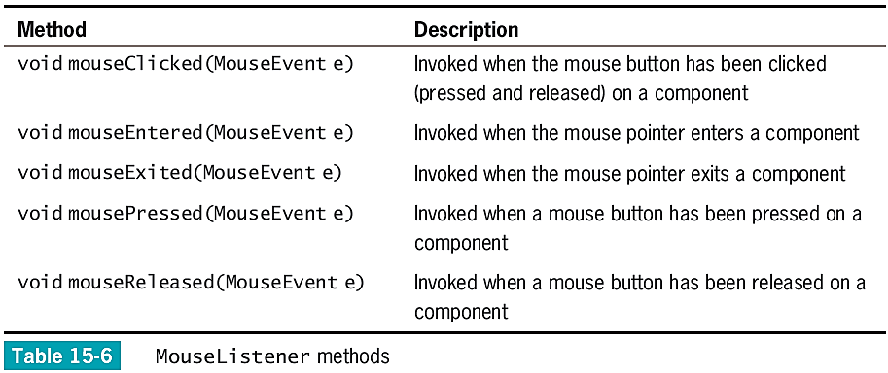
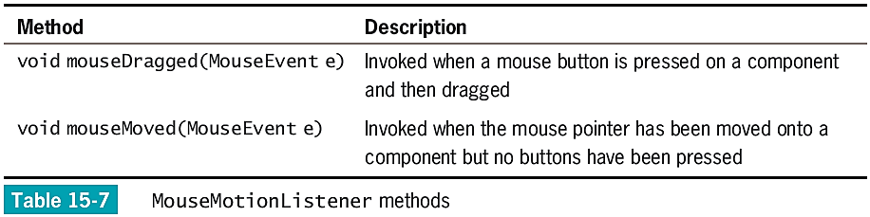
Handling Mouse Events

Slide 38
Handling Mouse Events
MouseInputListener interface
Implements all methods in both MouseListener and MouseMotionListener interfaces
Has no methods of its own
Handles many different types of mouse events
MouseEvent
The type of event generated by mouse manipulation
Contains instance methods and fields
Useful in describing mouse-generated events

Slide 39
Using Menus
Menus
Lists of user options
Classes:
JMenuBar
JMenu
JMenuItem
setJMenuBar() method
Adds the JMenuBar to a JFrame
add() method
Adds the JMenu to the JMenuBar

Slide 40
Using Specialized Menu Items
JCheckBoxMenuItem objects appear with a check box next to them
JRadioButtonMenuItem objects appear with a round radio button next to them
isSelected() method
Determines the state of a JCheckBoxMenuItem or JRadioButtonMenuItem

Slide 41
Using addSeparator()
Adds a horizontal line to menus in order to visually separate groups for your users
Does not change the functionality of the menu

Slide 42
Using setMnemonic()
Mnemonic
A key that causes an already-visible menu item to be chosen
setMnemonic() method
Provides a shortcut menu key for any visible menu item
Use a different mnemonic for each menu item
Accelerator
A key combination that causes a menu item to be chosen, whether or not it is visible
Only leaf menu items can have accelerators

Slide 43
Don’t Do It
Don’t forget that the content pane is operating behind the scenes
Don’t forget that when you create a custom Color object, 0 represents the darkest shade and 255 represents the lightest
Don’t forget to set a layout manager
Don’t forget to use a region when adding a component to a BorderLayout
Don’t use add() to place a JFrame’s menu bar
Don’t use the same mnemonic for multiple menu items

Slide 44
Summary
Layout manager
An object that controls the size and position of components inside a Container object
BorderLayout
FlowLayout
GridLayout
CardLayout
GridBagLayout
Use JPanels within other JPanels
Create an infinite variety of screen layouts

Slide 45
Summary
Events are Objects that the user initiates
Implement the appropriate listener interface for your class
Event handlers
Interface methods automatically called when an event occurs
KeyListener interface
Handles keyboard events
MouseListener interface
Handles mouse events

